Slide 1

Inheritance
Inheritance

Slide 2
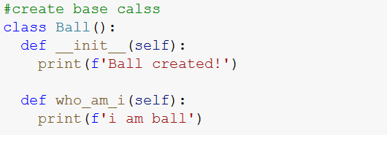
Create Base Class
Inheritance

Slide 3
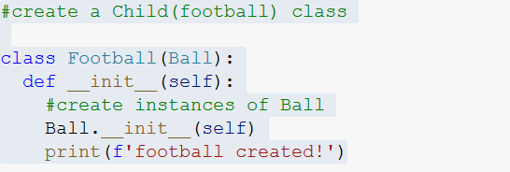
Create child Class
Inheritance

Slide 4


Create Object & call base class method
Inheritance

Slide 5
Use the Super() Function
Python has a super() function that will make the child class inherit all the methods and properties from its parent
By using the super() function, you do not have to use the name of the parent element, it will automatically inherit the methods and properties from its parent.
Inheritance

Slide 6
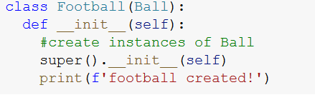
Use the Super() Function
Inheritance

Slide 7
Overriding
When a method in a subclass has the same name, same parameters or signature and same return type(or sub-type) as a method in its super-class, then the method in the subclass is said to override the method in the super-class.
Inheritance

Slide 8
Overriding example
Base Class
Ball
who_am_i()
Overriding
Extends
Child Class
FootBall
who_am_i()
Inheritance

Slide 9
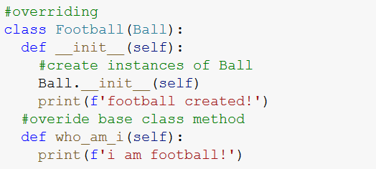
Overriding example
Inheritance

Slide 10
Thank you!
OOP using python

